Slide 1
Arduino 101

Slide 2
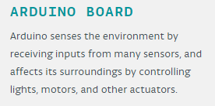
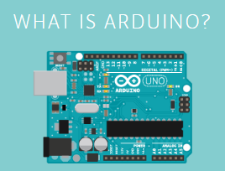
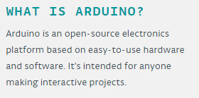
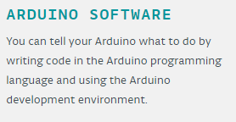
https://www.arduino.cc/

Slide 3
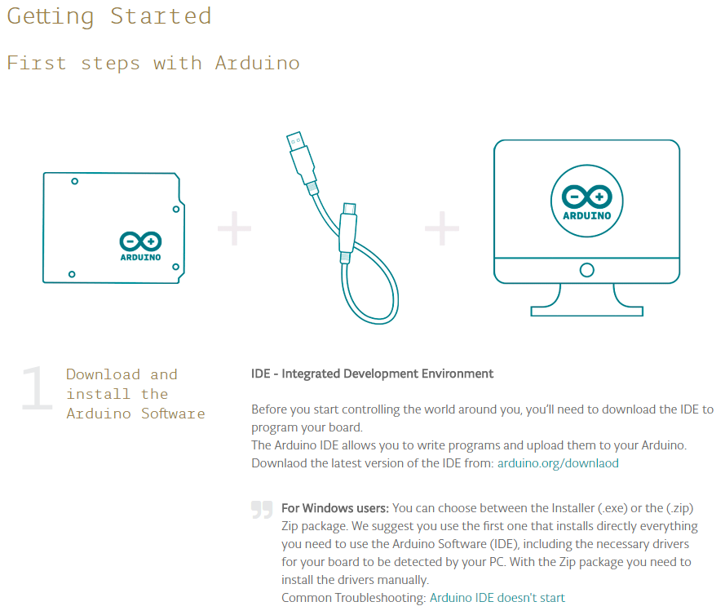
Getting Started
http://www.arduino.org/learning/getting-started

Slide 4
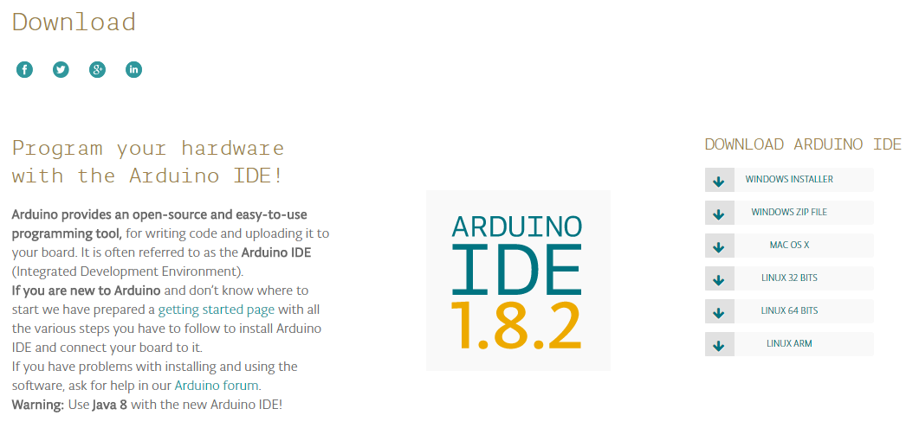
http://www.arduino.org/downloads

Slide 5
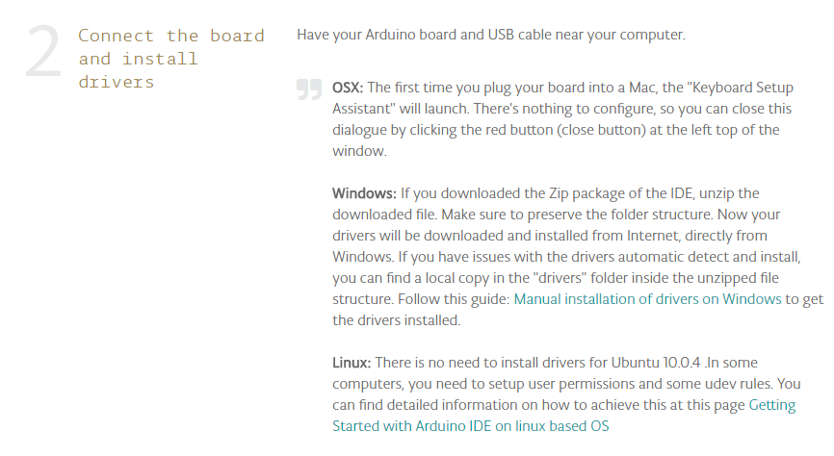

Slide 6
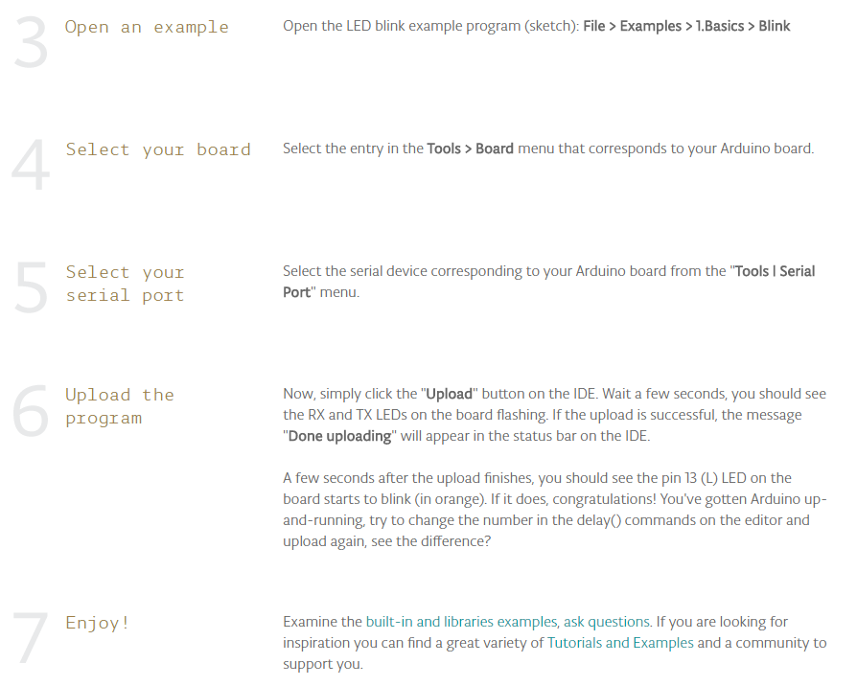

Slide 7
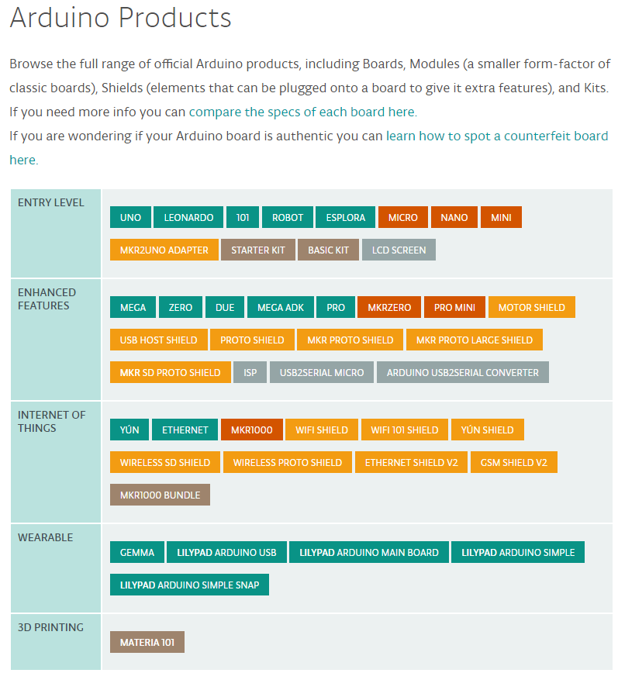

Slide 8
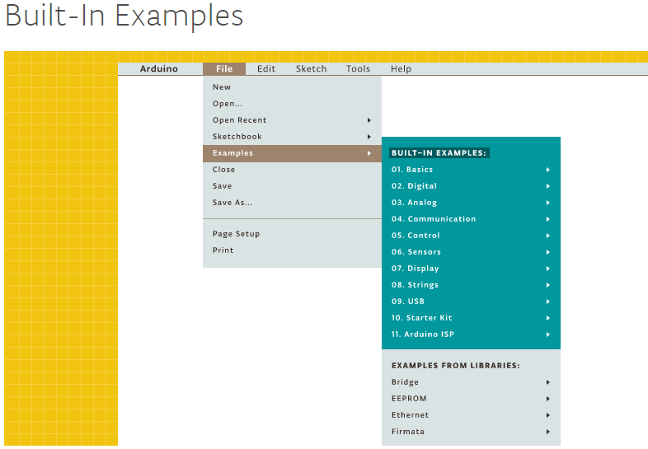

Slide 9
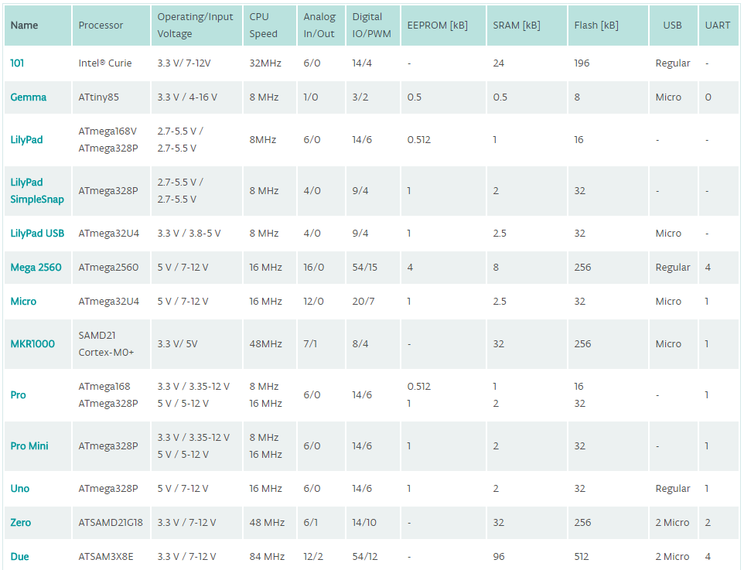

Slide 10
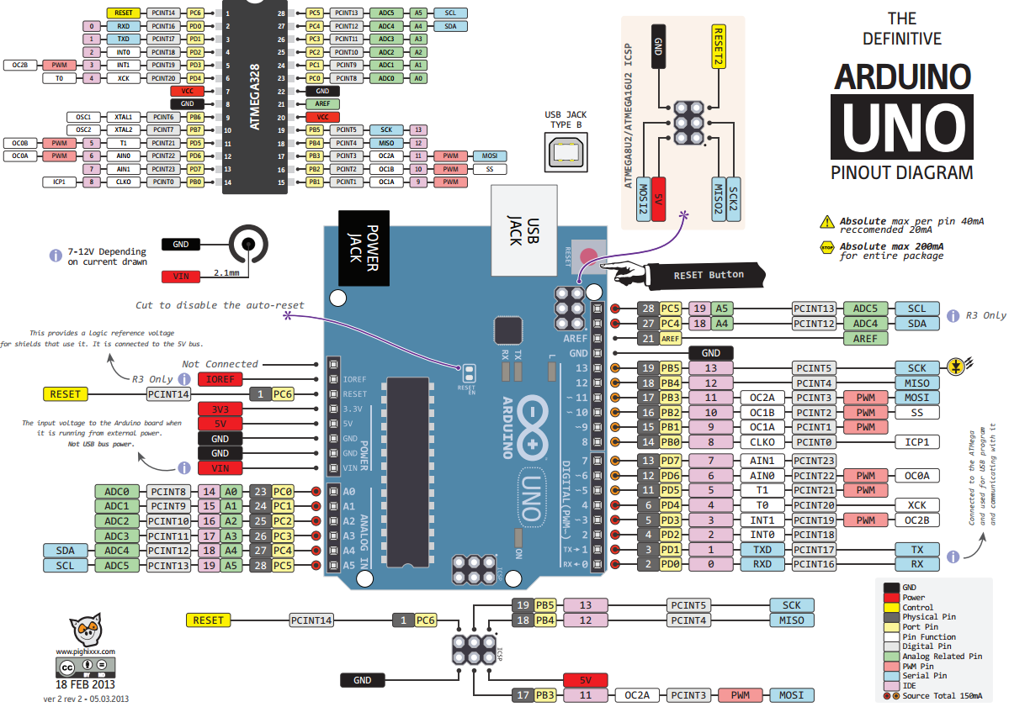

Slide 11
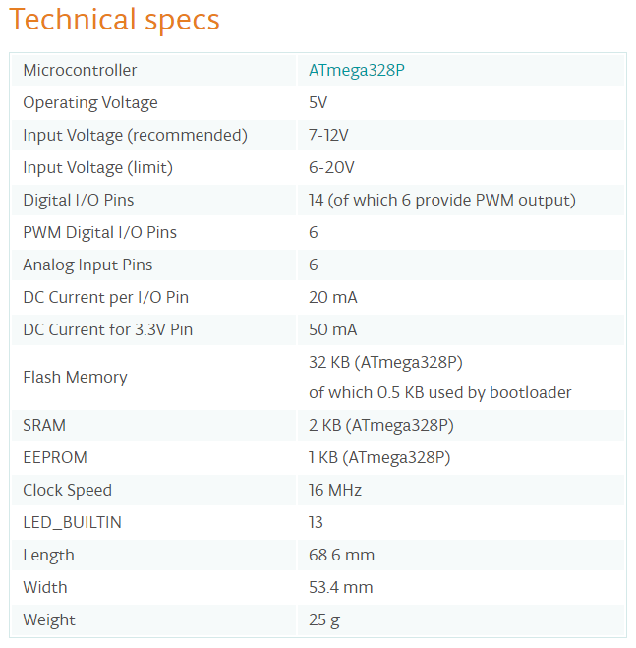

Slide 12

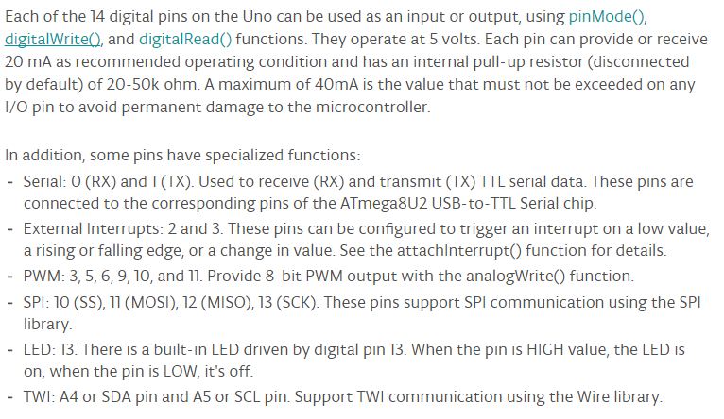

Slide 13
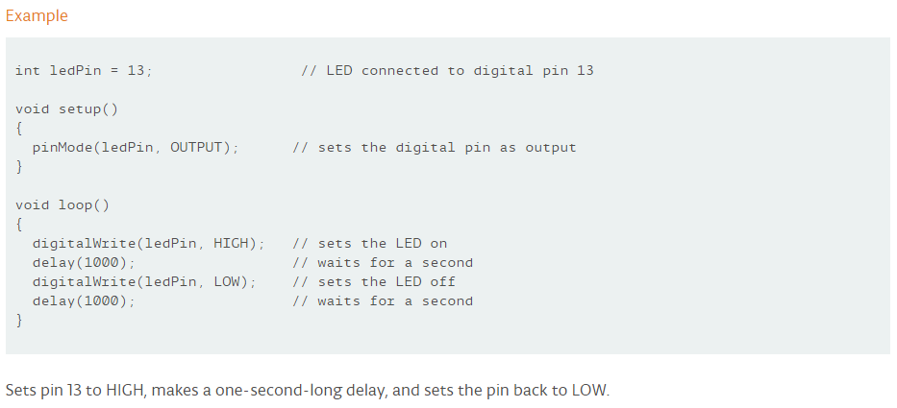
digitalWrite()

Slide 14
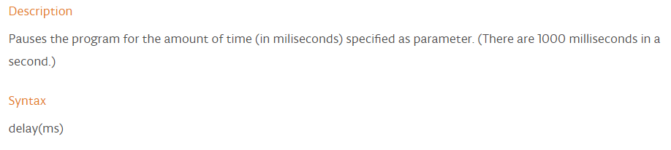

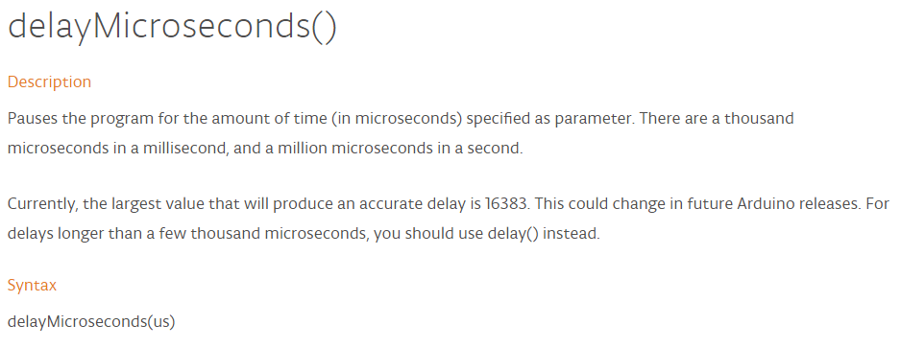
delay
delay()
delayMicroseconds()

Slide 15
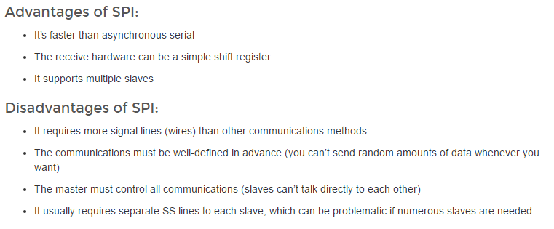
SPI
https://learn.sparkfun.com/tutorials/serial-peripheral-interface-spi

Slide 16
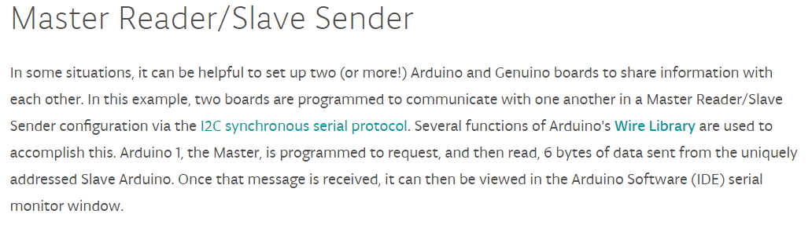
I2C
https://www.arduino.cc/en/Tutorial/MasterReader

Slide 17
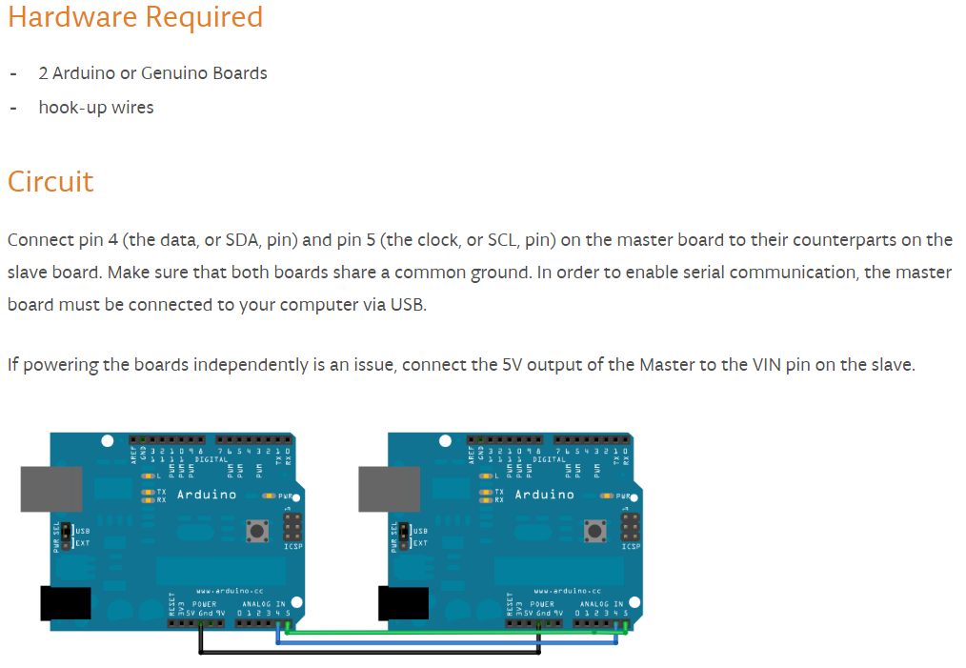
I2C

Slide 18
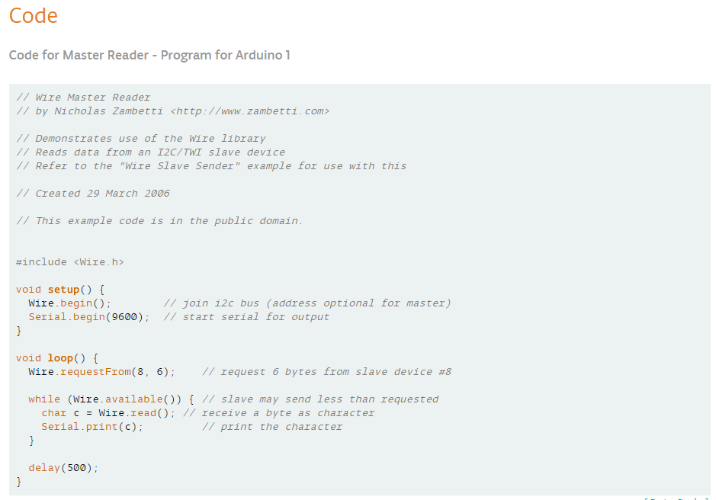
I2C

Slide 19
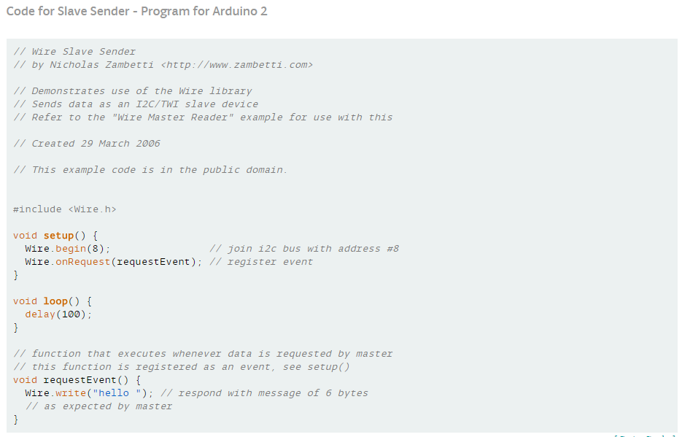
I2C

Slide 20
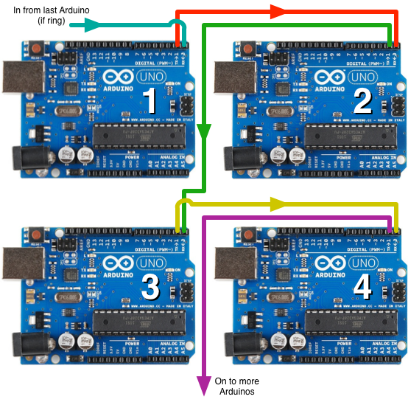
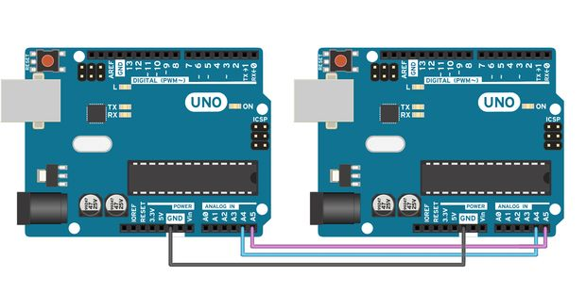
Why use multiple controllers?
Limited memory
Limited speed
Limited resources (e.g., IO pins, and Analog pins)

Slide 21
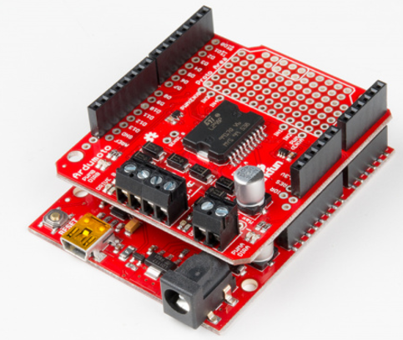
Shields
Same form factor as the main Arduino board
Libraries provided can easily be incorporated into the main sketch
Advantages
No need wiring/soldering
No extra power required

Slide 22
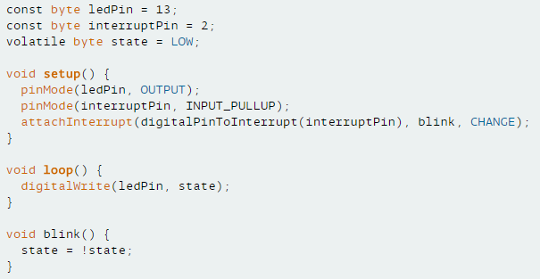
Interrupt
https://www.arduino.cc/en/Reference/attachInterrupt
attachInterrupt(digitalPinToInterrupt(pin), ISR, mode);

Slide 24
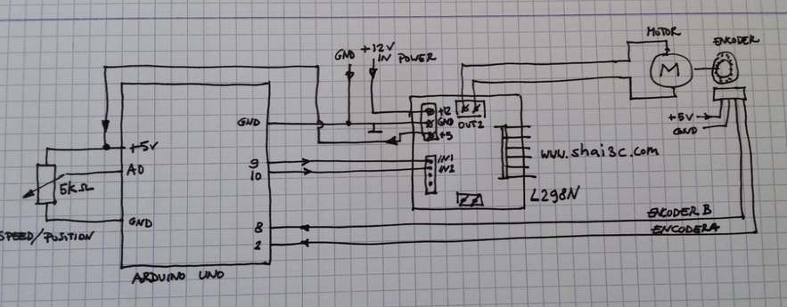
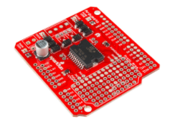
Motor position control
https://www.allaboutcircuits.com/projects/use-an-arduino-to-control-a-motor/
https://www.youtube.com/watch?v=BIq-sIvN080
Motor shield at
https://www.sparkfun.com/products/10182
SparkFun Ardumoto - Motor Driver Shield
https://www.sparkfun.com/products/14129

Slide 25
How to power the project
https://learn.sparkfun.com/tutorials/how-to-power-a-project

Slide 29
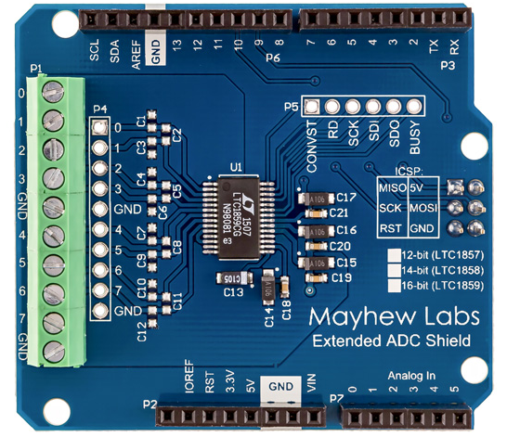
Case study 1)
Extended ADC shield from Mayhew Labs
Communication via SPI interface
Input range : +/- 10V
Speed : 200 K samples/sec
ADC shield sits on Arduino UNO board
Arduino sends data to myRIO using I2C interface

Slide 30
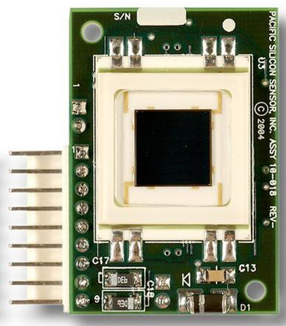
PSD module (DL100-7-PCBA3) for sensing motion

Slide 32
Home automation project
https://create.arduino.cc/projecthub/AnuragVasanwala/home-automation-0dcefc

